Slide 1
Automated Change Detection of Building Footprints in Dubai
1/47

Slide 2
Agenda
2/47
Introduction
Proposed Methodology
Results & Discussion
Challenges and future work

Slide 3
Introduction
3/47
Building Footprints, Change Detection, Siamese Networks

Slide 4
Introduction
4/47
Building footprint segmentation involves identifying and outlining the location and shape of buildings from aerial or satellite imagery.
Building footprints are important for many applications, like urban planning, infrastructure management, and land use analysis.
Accurate segmentation of building footprints is needed for change detection, which enables the identification of new constructions, demolitions, or building alterations over time.
Dabove, P., Daud, M. & Olivotto, L. Revolutionizing urban mapping: deep learning and data fusion strategies for accurate building footprint segmentation. Sci Rep 14, 13510 (2024). https://doi.org/10.1038/s41598-024-64231-0
W. Liu et al., "Building Footprint Extraction From Unmanned Aerial Vehicle Images Via PRU-Net: Application to Change Detection," in IEEE Journal of Selected Topics in Applied Earth Observations and Remote Sensing, vol. 14, pp. 2236-2248, 2021, doi: 10.1109/JSTARS.2021.3052495.

Slide 5
Related Work
5/47
Rule-Based Approaches: use predefined geometric thresholds to extract footprints, but lack adaptability for complex, high-resolution urban environments.
Machine Learning Approaches: Use feature-based algorithms (e.g. Random Forest) to classify buildings based on color, texture, or shape, but require manual feature extraction and struggle with varying urban complexities.
Deep Learning Approaches: CNNs achieve highly accurate and robust semantic segmentation but demand high computational resources and face generalization challenges across diverse datasets.
Data Fusion Approaches: multiple data sources (RGB imagery with elevation models) enhance boundary detection and accuracy, depends on data alignment and compatibility.
Dabove, P., Daud, M. & Olivotto, L. Revolutionizing urban mapping: deep learning and data fusion strategies for accurate building footprint segmentation. Sci Rep 14, 13510 (2024). https://doi.org/10.1038/s41598-024-64231-0

Slide 6
Siamese Networks
6/47
Siamese networks compare remote sensing images across different time periods by extracting their features and calculating differences between feature vectors to detect change regions.
Siamese Network consists of two twin subnetworks that share weights. Each subnetwork takes one input, and the outputs of both are compared to determine the similarity using a distance metric.
T. Wu, Z. Sun, Z. Zhao, J. Wang, R. Yu and J. Ji, "SFCF-Net: A Cross-Hierarchical Progressive Feature Integration Network for UAV Image Change Detection," in IEEE Journal of Selected Topics in Applied Earth Observations and Remote Sensing, vol. 19, pp. 9127-9143, 2026, doi: 10.1109/JSTARS.2026.3664258.
Y. Li, C. L. P. Chen and T. Zhang, "A Survey on Siamese Network: Methodologies, Applications, and Opportunities," in IEEE Transactions on Artificial Intelligence, vol. 3, no. 6, pp. 994-1014, Dec. 2022, doi: 10.1109/TAI.2022.3207112.
T. Chen, Z. Lu, Y. Yang, Y. Zhang, B. Du and A. Plaza, "A Siamese Network Based U-Net for Change Detection in High Resolution Remote Sensing Images," in IEEE Journal of Selected Topics in Applied Earth Observations and Remote Sensing, vol. 15, pp. 2357-2369, 2022

Slide 7
Proposed Methodology
7/47
Dataset Preprocessing, Model Training, Model Evaluation

Slide 8
Proposed Methodology
8/47
Dataset Preprocessing
  Co-registration
  Tiling and Normalization
  Manual Annotation
Model Training:
  Supervised Training of VGG16 on LEVIR-CD Dataset
  Run LEVIR-CD-trained Model Inference on Dubai Data
  Manually Label Sample Buildings for Ground-Truth Values
  Semi-Supervised Fine-Tuning of Pretrained Model
Model Evaluation
  Evaluate Model on Ground-Truth Test Split
  Visual Inspection

Slide 9
Dataset Preprocessing
9/47
Co-registration: Ensure the images are perfectly aligned pixel-to-pixel. If one image is shifted even slightly, the model will flag the edges of every building as a change.
Tiling (Patching): Slice both images into smaller, manageable patches (256x256 pixels) using a sliding window to fit GPU memory.
Normalization: Scale the RGB pixel values (0-255) to a standard range (0 to 1) so the model processes the data efficiently.

Slide 10
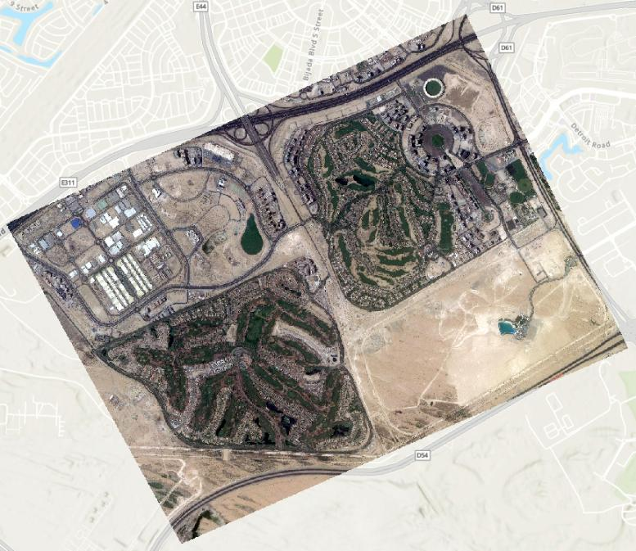
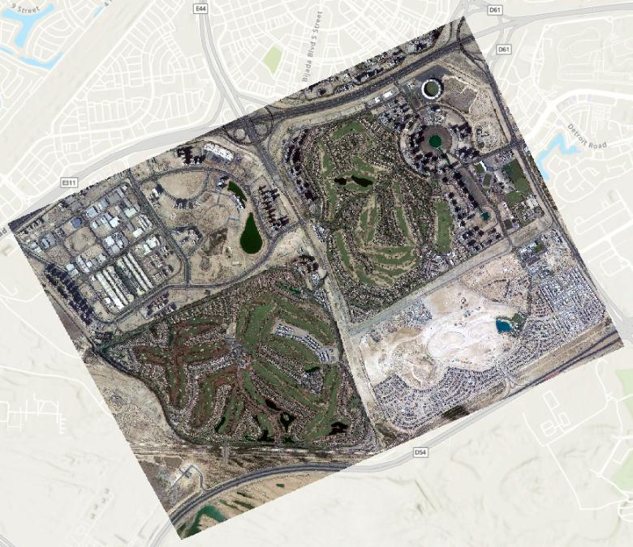
Dataset Preprocessing – Co-Registration
10/47
Dubai, 2019
Dubai, 2023

Slide 11
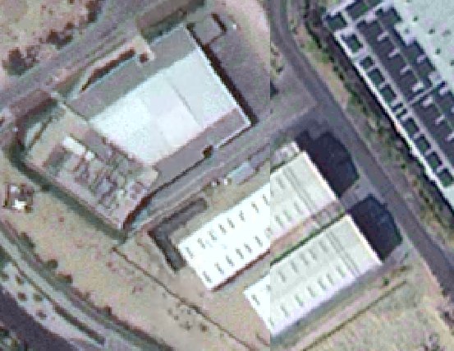
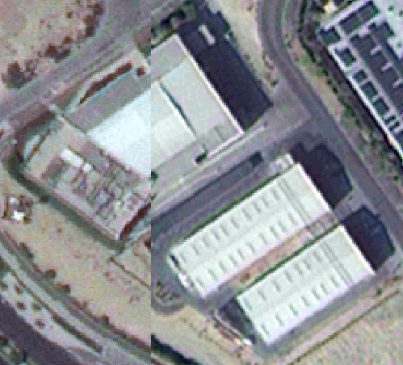
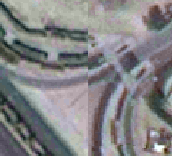
Dataset Preprocessing – Co-Registration
11/47
Precise co-registration/layer alignment is important for direct pixel-to-pixel analysis.
Visual inspection of the two satellite images show slight misalignment.

Slide 12
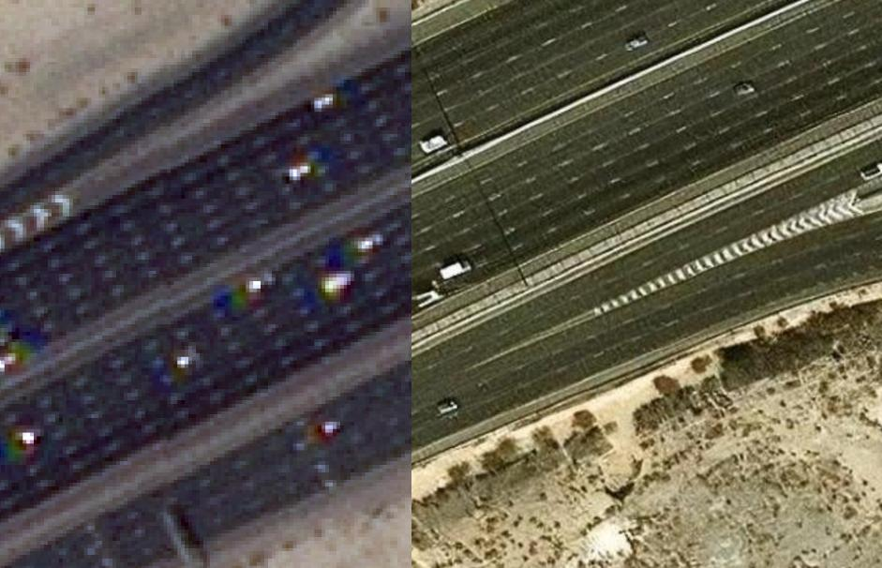
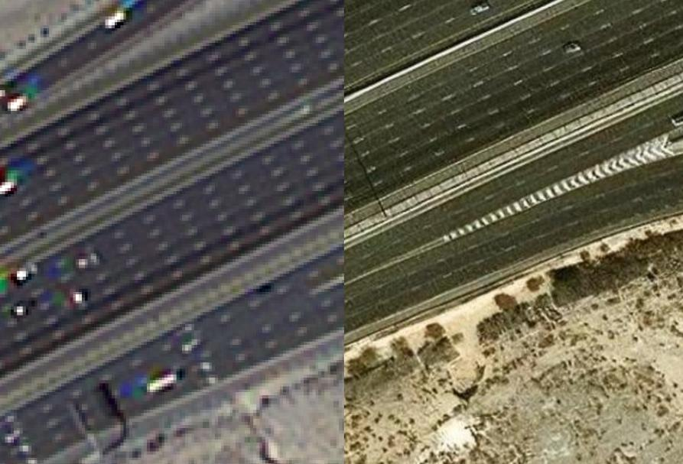
12/47
Dubai, 2019 -> Reference Layer
Dubai, 2023 -> we align this layer
Compare both satellite images to an esri imagery basemap to find the correctly aligned reference layer.

Slide 13
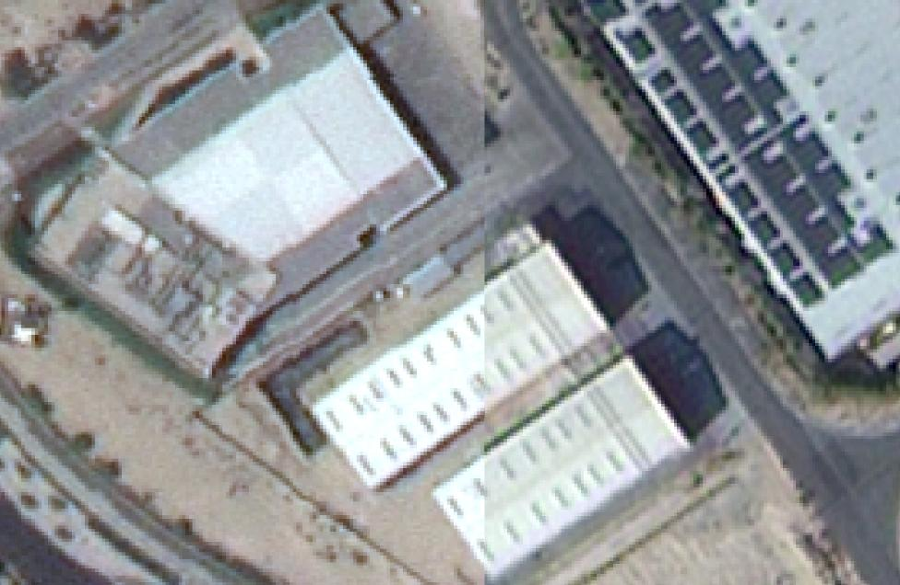
13/47
Dataset Preprocessing – Co-Registration
After Georeferencing using manual control points on ArcGIS.

Slide 14
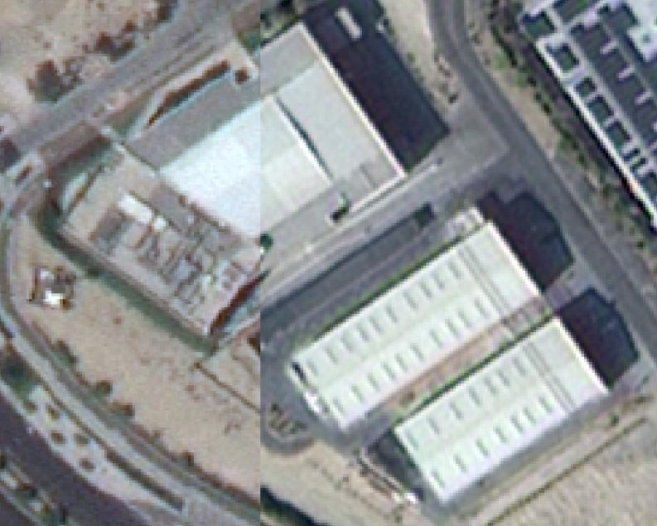
14/47
Dataset Preprocessing – Co-Registration
After Georeferencing using manual control points.

Slide 15
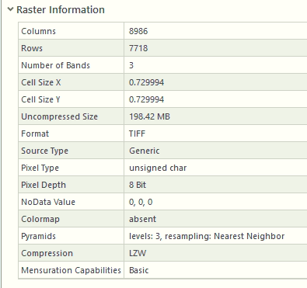
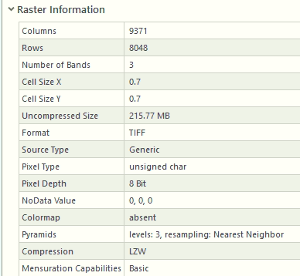
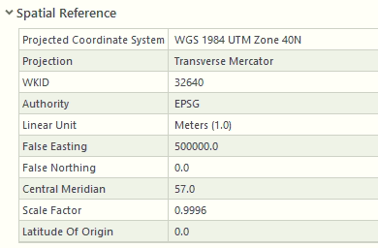
15/47
Dataset Preprocessing – Co-Registration
The raster on the left (2019) has a cell size of 0.729994, while the raster on the right (2023) is 0.7.
Because their pixels represent different physical dimensions on the ground, the pixel grids cannot perfectly align, even if they are placed over the exact same geographic location.
The left image is 8986 x 7718 pixels, and the right is 9371 x 8048 pixels.
The fact that both resolution and dimensions differ reflects misalignment.
Dubai, 2019
Dubai, 2023

Slide 16
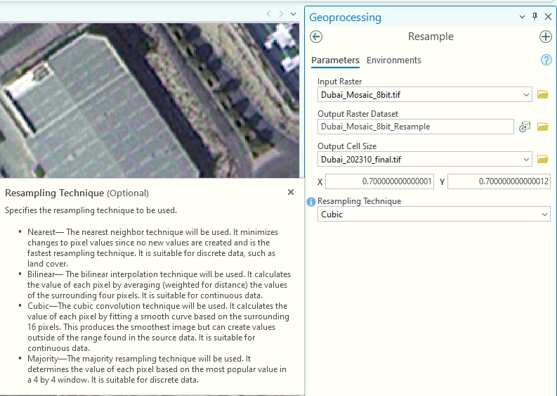

16/47
Dataset Preprocessing – Co-Registration
Resampled the 0.729994 resolution raster (2019) to 0.7 (matching 2023) using Cubic Convolution with the Resample tool.
Match the dimensions of the 2023 raster (8986 x 7718) to the same extent as the 2019 raster (9371 x 8048) with the Clip Raster tool.

Slide 17
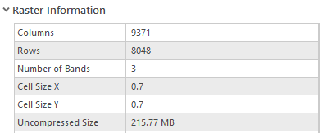
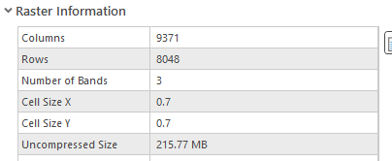
17/47
Dataset Preprocessing – Co-Registration
Dubai, 2019
Dubai, 2023

Slide 18
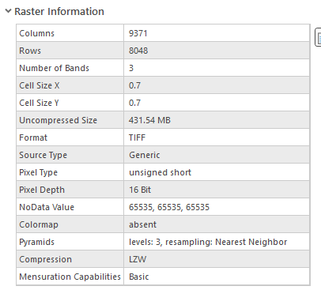
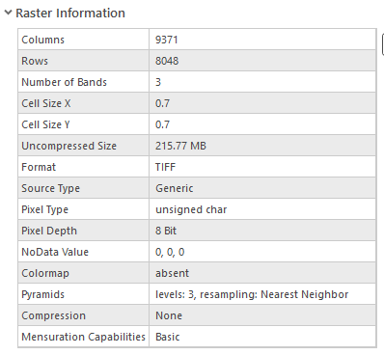
18/47
Dataset Preprocessing – Bit Conversion
The 2019 image has a pixel depth of 16 bits, while 2023 is 8 bits.
Thus we convert the 2019 image to 8 bits to address potential misalignment.
Dubai, 2019
Dubai, 2023

Slide 19
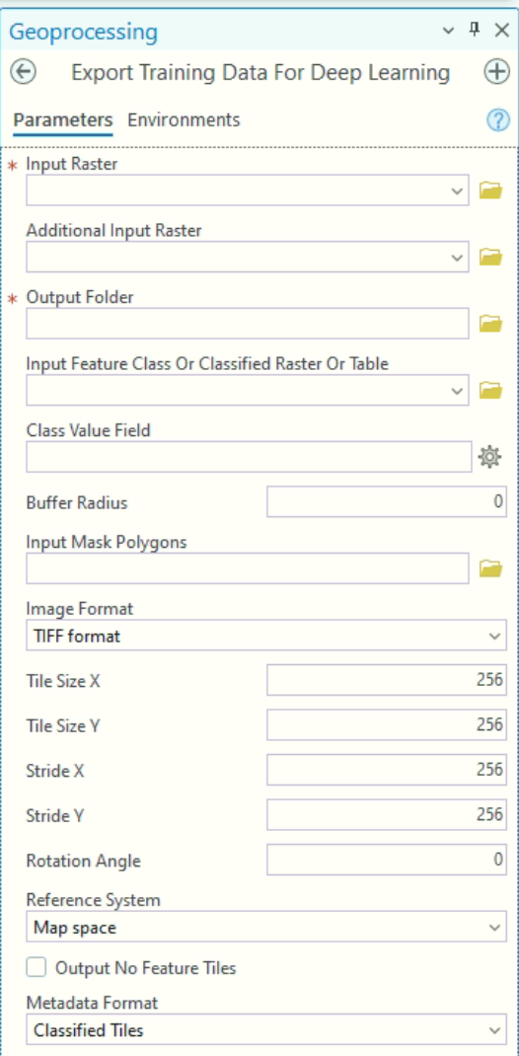
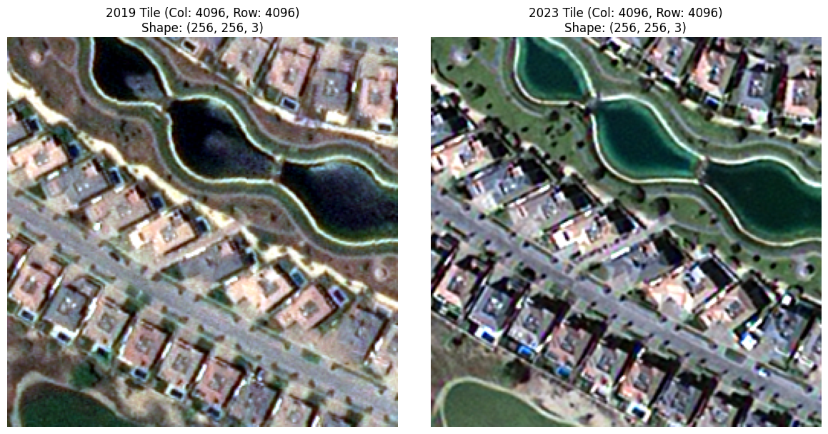
19/47
Dataset Preprocessing Tiling (256x256)
684 non-overlapping tiles of 256x256 resolution.

Slide 20
Radiometric Normalization
20/47
Satellite sensors measuring the same patch of ground on two different dates will record different pixel values even if nothing on the ground actually changed.
Atmospheric conditions (haze, aerosols, water vapour), sun angle, and sensor drift all alter the brightness of the signal.
Radiometric normalization minimizes these differences so that only genuine ground change remains.

Slide 21
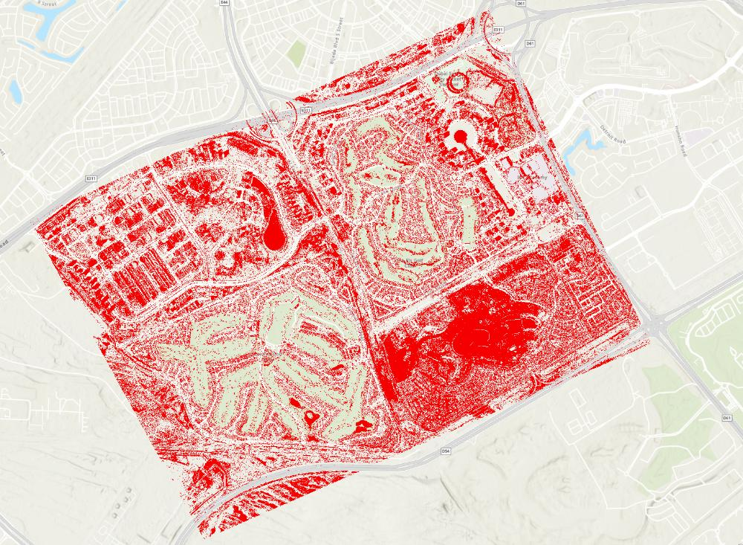
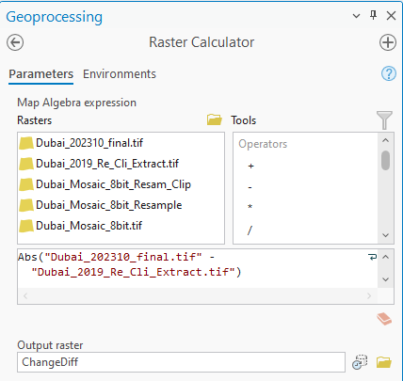
Baseline Experiment: Computer Vision Pixel Differencing
21/47
Calculate the pixel difference on a threshold between the 2019 and the 2023 maps using ArcGIS.
Noisy approach, doesn’t discriminate buildings from shade/light/etc…
Motivation to utilize deep learning AI models for change detection.

Slide 22
Next Experiment: Supervised VGG16 Model
22/47
First, we train a supervised VGG16 ImageNet model on the LEVIR-CD Dataset and run inference on our dubai images.

Slide 23
LEVIR-CD Dataset
23/47
LEVIR-CD is a large-scale remote sensing building Change Detection dataset.
637 very high-resolution (VHR, 0.5m/pixel) Google Earth (GE) image patch pairs with a size of 1024 × 1024 pixels.
Covers various types of buildings, such as villa residences, tall apartments, small garages and large warehouses.
These bitemporal images are annotated by remote sensing image interpretation experts using binary labels (1 for change and 0 for unchanged).
31,333 individual change building instances across 20 different regions in several cities in Texas of the US, varying from 2002 to 2018.
Access: https://justchenhao.github.io/LEVIR/
Chen, H.; Shi, Z. A Spatial-Temporal Attention-Based Method and a New Dataset for Remote Sensing Image Change Detection. Remote Sens. 2020, 12, 1662. https://doi.org/10.3390/rs12101662

Slide 24
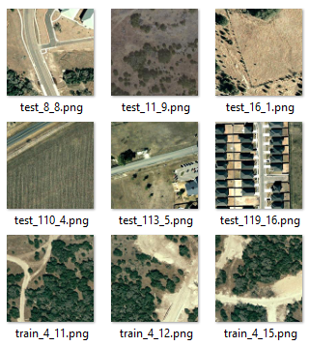
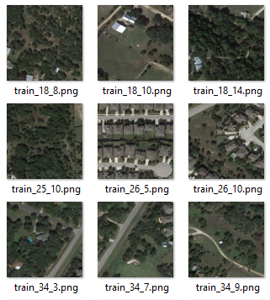
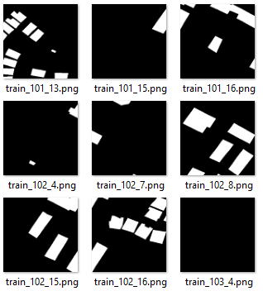
LEVIR-CD Dataset
24/47

Slide 25
VGG16 Model Training Results on LEVIR-CD
25/47
Metric | Value
F1 Score | 0.9361
Precision | 0.9436
Recall | 0.9287
Overall Accuracy | 0.9942
Intersection over Union (IoU) | 0.8799
Kappa | 0.9331

Slide 26
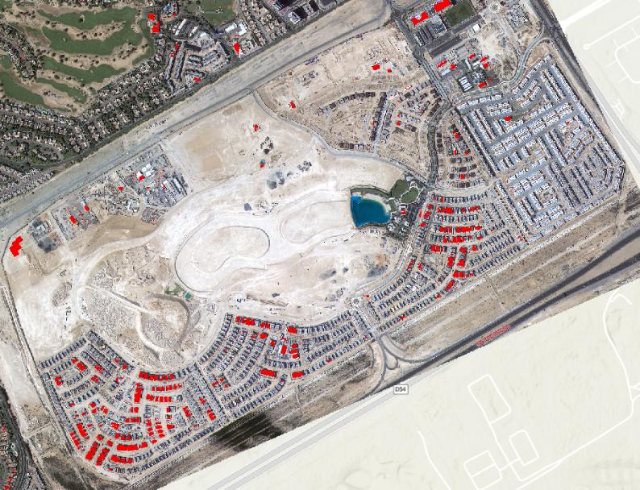
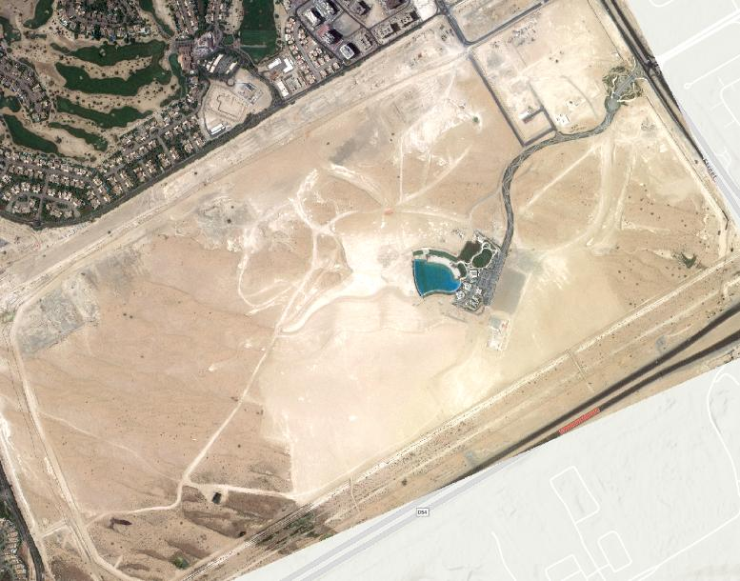
Dubai Satellite Model Inference
26/47
The Fully-Supervised Model is trained on Western-style residential areas with pitched, dark roofs surrounded by green vegetation. Dubai’s urban topology consists of highly reflective flat roofs, dense high-rises with significant shadow casting, and a background of sand and arid surfaces. Thus, the model shows weaker performance on arid regions with sand like the UAE.
Motivation for Semi-Supervised Fine-Tuning of the Model on our Dubai satellite data.

Slide 27
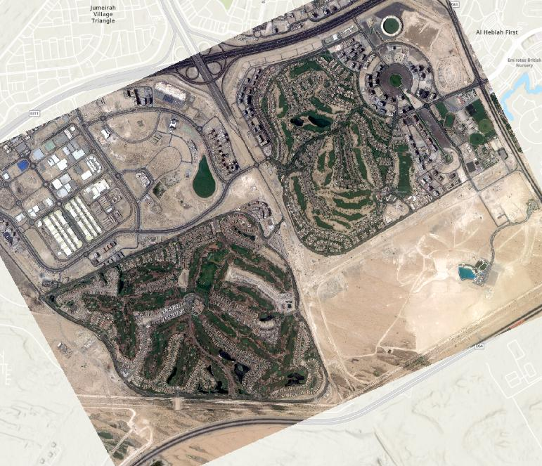
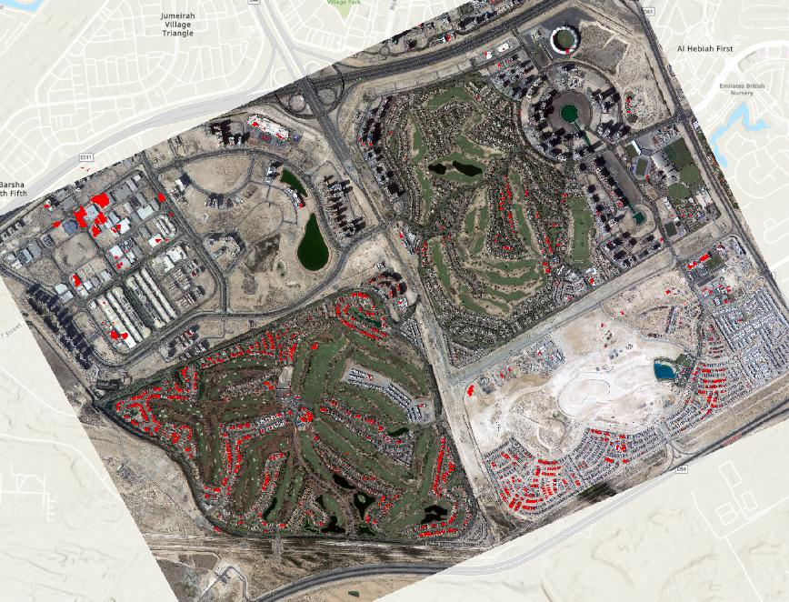
27/47

Slide 28
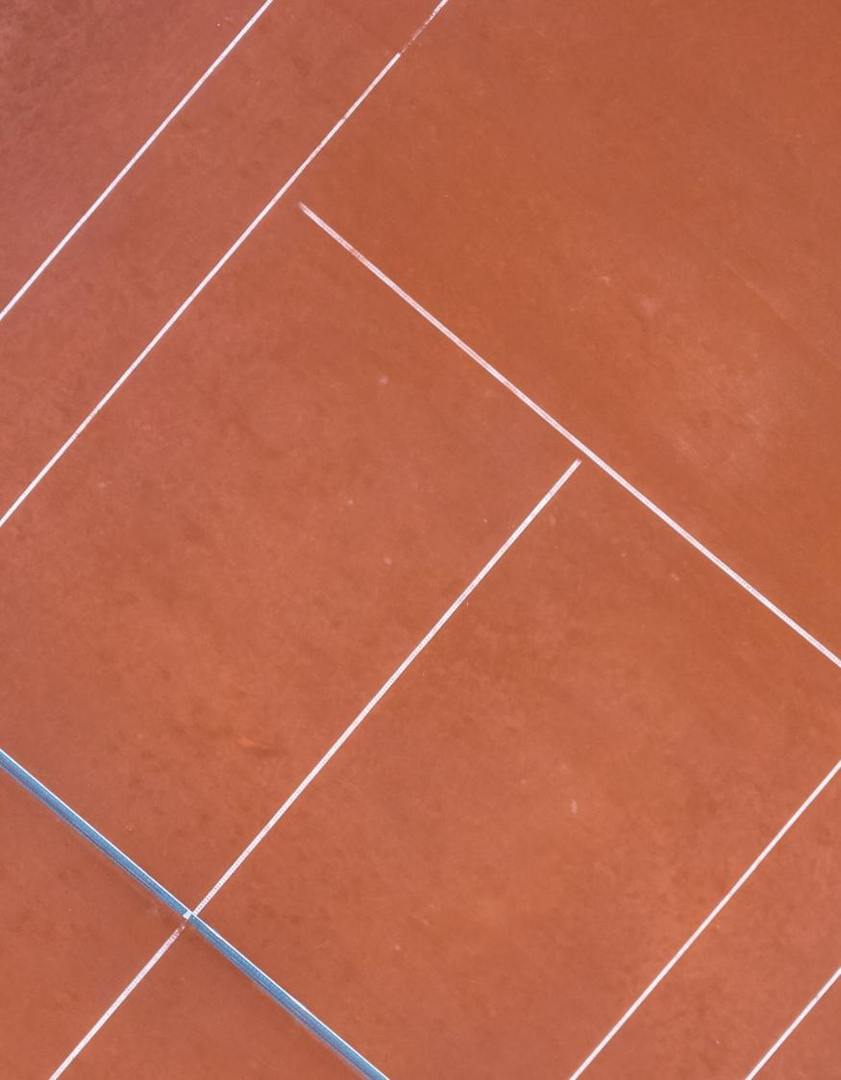
Ground-Truth Manual Annotation Strategy
28/47
We select and mask tiles from diverse areas across the images.
Train the baseline Siamese network on this supervised set.
Run the trained baseline over the remaining unlabeled tiles.
Look at the predictions where the network produces incorrect masks.
Manually label some of these challenging tiles (semi-supervised active learning).
Start a new round of training using the expanded dataset.
This ensures that we are teaching the model the complex features it struggles with, rather than redundant, easy examples.

Slide 29
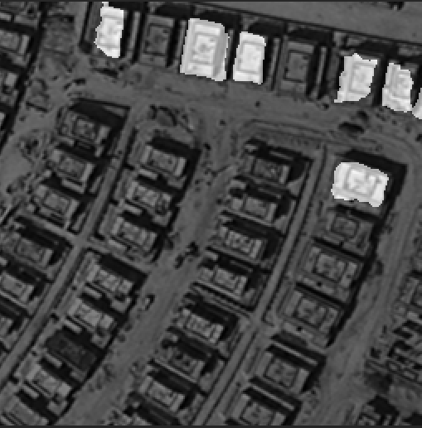
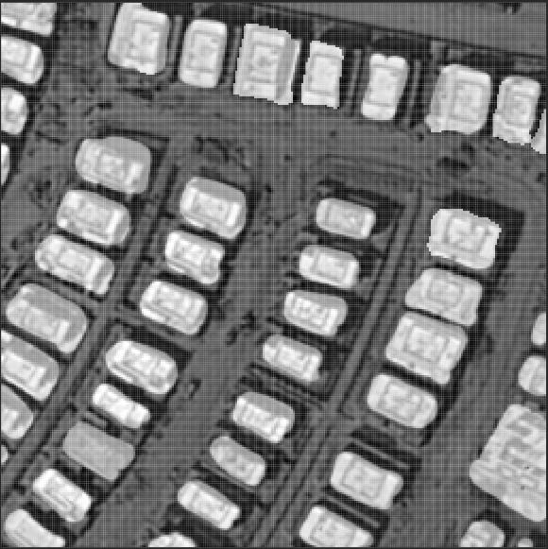
Ground-Truth Manual Annotation
29/47
Original Prediction
Manual Annotation

Slide 30
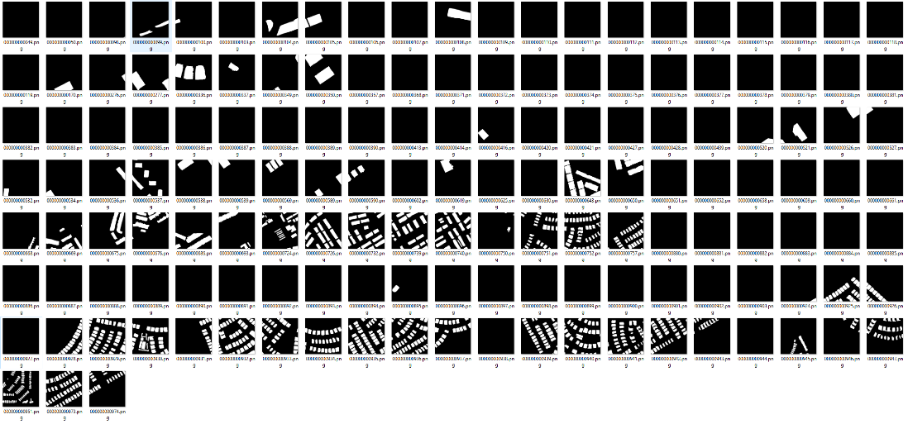
Ground-Truth Manual Annotation
30/47
306 labelled tiles (~45% of the total data).
226 unchanged tiles (~74%).
80 changed tiles (~26%).

Slide 31
Dataset Split Strategy
31/47
Approximately 1/4th of the satellite image contains changed building.
The remaining areas contain unchanged buildings and landscape.
Heuristic: each dataset split should contain approximately 25% positive samples (changed buildings) to be representative of this distribution.

Slide 32
32/47
Semi-Supervised Dataset Split
Split | Total | Positive (25%) | Negative (75%)
Train (~65%) | 200 | 52 | 148
Validation (~20%) | 60 | 15 | 45
Test (~15%) | 46 | 13 | 33
306 labelled samples out of 684 tiles in total.

Slide 33
Data Augmentations
33/47
Augmentation | Applied To | Probability
Horizontal flip | 2019 tiles, 2023 tiles, labels | 0.5
Vertical flip |  | 0.5
Rotation |  | 0.2
Random crop |  | 0.75
Mosaic stitching |  | 0.25
Brightness | 2019 tiles, 2023 tiles | Always
Contrast |  | Always
Saturation |  | Always
Sharpness |  | Always
Gaussian blur |  | 0.5

Slide 34
Evaluation Metrics
34/47
F1: Harmonic mean of Precision and Recall. The primary metric for change detection because a model that misses changes and one that over-predicts changes will both score poorly.
Precision: Of all pixels the model flagged as "changed", what fraction actually were? High precision means few false alarms.
Recall: Of all pixels that truly changed, what fraction did the model catch? High recall means few missed changes.
Overall Accuracy: Percentage of all pixels classified correctly, including background.
Kappa: Corrects overall accuracy for statistical chance. A Kappa of 0 means the model is no better than random guessing, 1.0 is perfect.
Intersection over Union (IoU): Overlap between the predicted change mask and the ground truth mask, divided by their union. Partial overlaps are penalised.
Diallo, R., Edalo, C., Awe, O.O. (2025). Machine Learning Evaluation of Imbalanced Health Data: A Comparative Analysis of Balanced Accuracy, MCC, and F1 Score. In: Awe, O.O., A. Vance, E. (eds) Practical Statistical Learning and Data Science Methods. STEAM-H: Science, Technology, Engineering, Agriculture, Mathematics & Health. Springer, Cham. https://doi.org/10.1007/978-3-031-72215-8_12
Jineon Kim, Yong-Ki Lee, Chae-Soon Choi, Sayedalireza Fereshtenejad, Jae-Joon Song, Scanline intersection similarity: A similarity metric for joint trace maps, Computers & Geosciences, Volume 175, 2023, 105358, ISSN 0098-3004, https://doi.org/10.1016/j.cageo.2023.105358

Slide 35
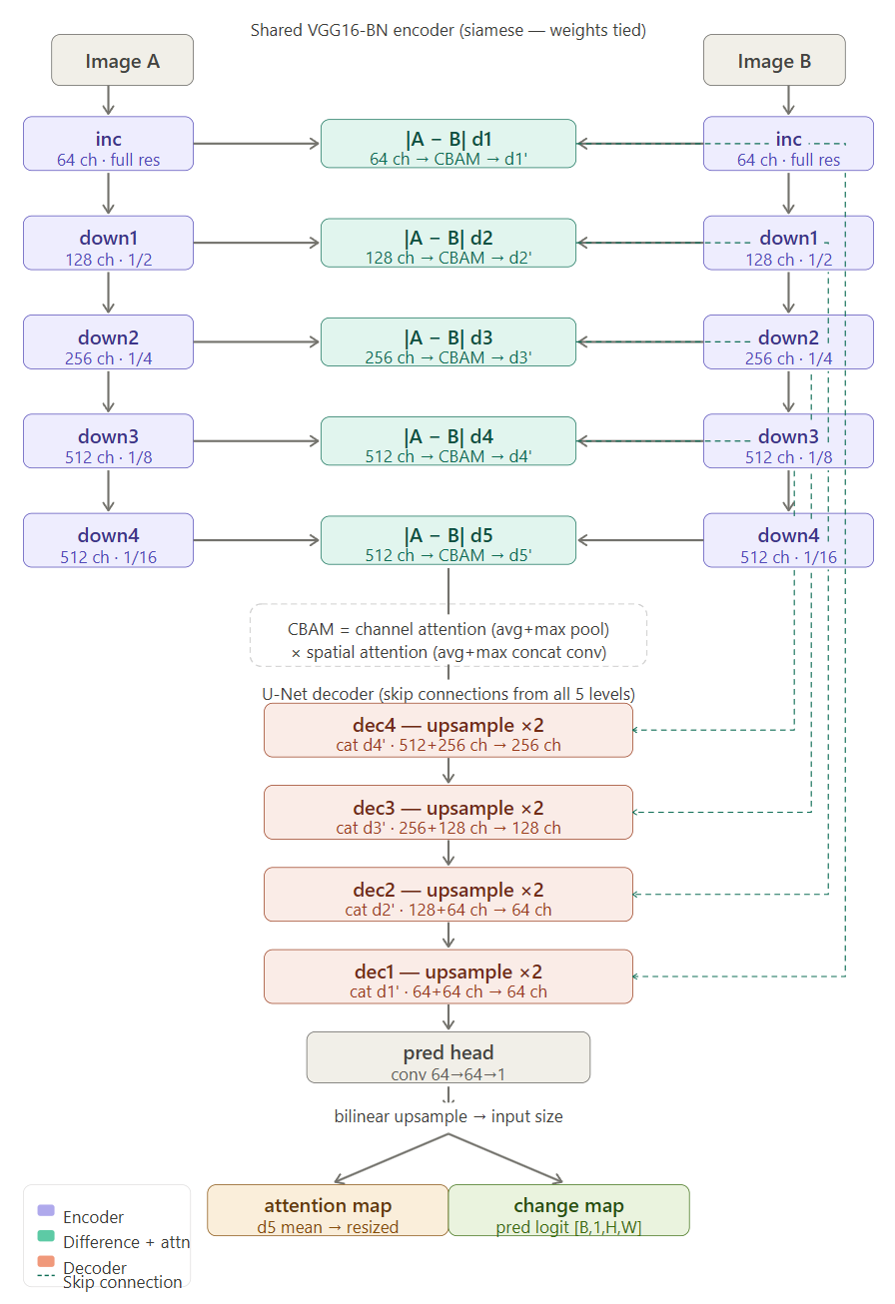
Model Architecture
35/47
VGG16 ImageNet Weights Encoder + Custom Decoder

Slide 36
Results and Discussion
36/47
Model Performance and Predictions

Slide 37
Model Evaluation
37/47
Metric | Value
F1 Score | 0.8321
Precision | 0.7856
Recall | 0.8845
Overall Accuracy | 0.9789
Intersection over Union (IoU) | 0.7125
Kappa | 0.8210

Slide 38
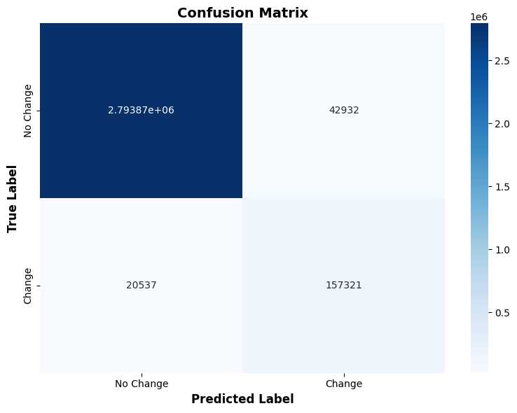
Confusion Matrix
38/47

Slide 39
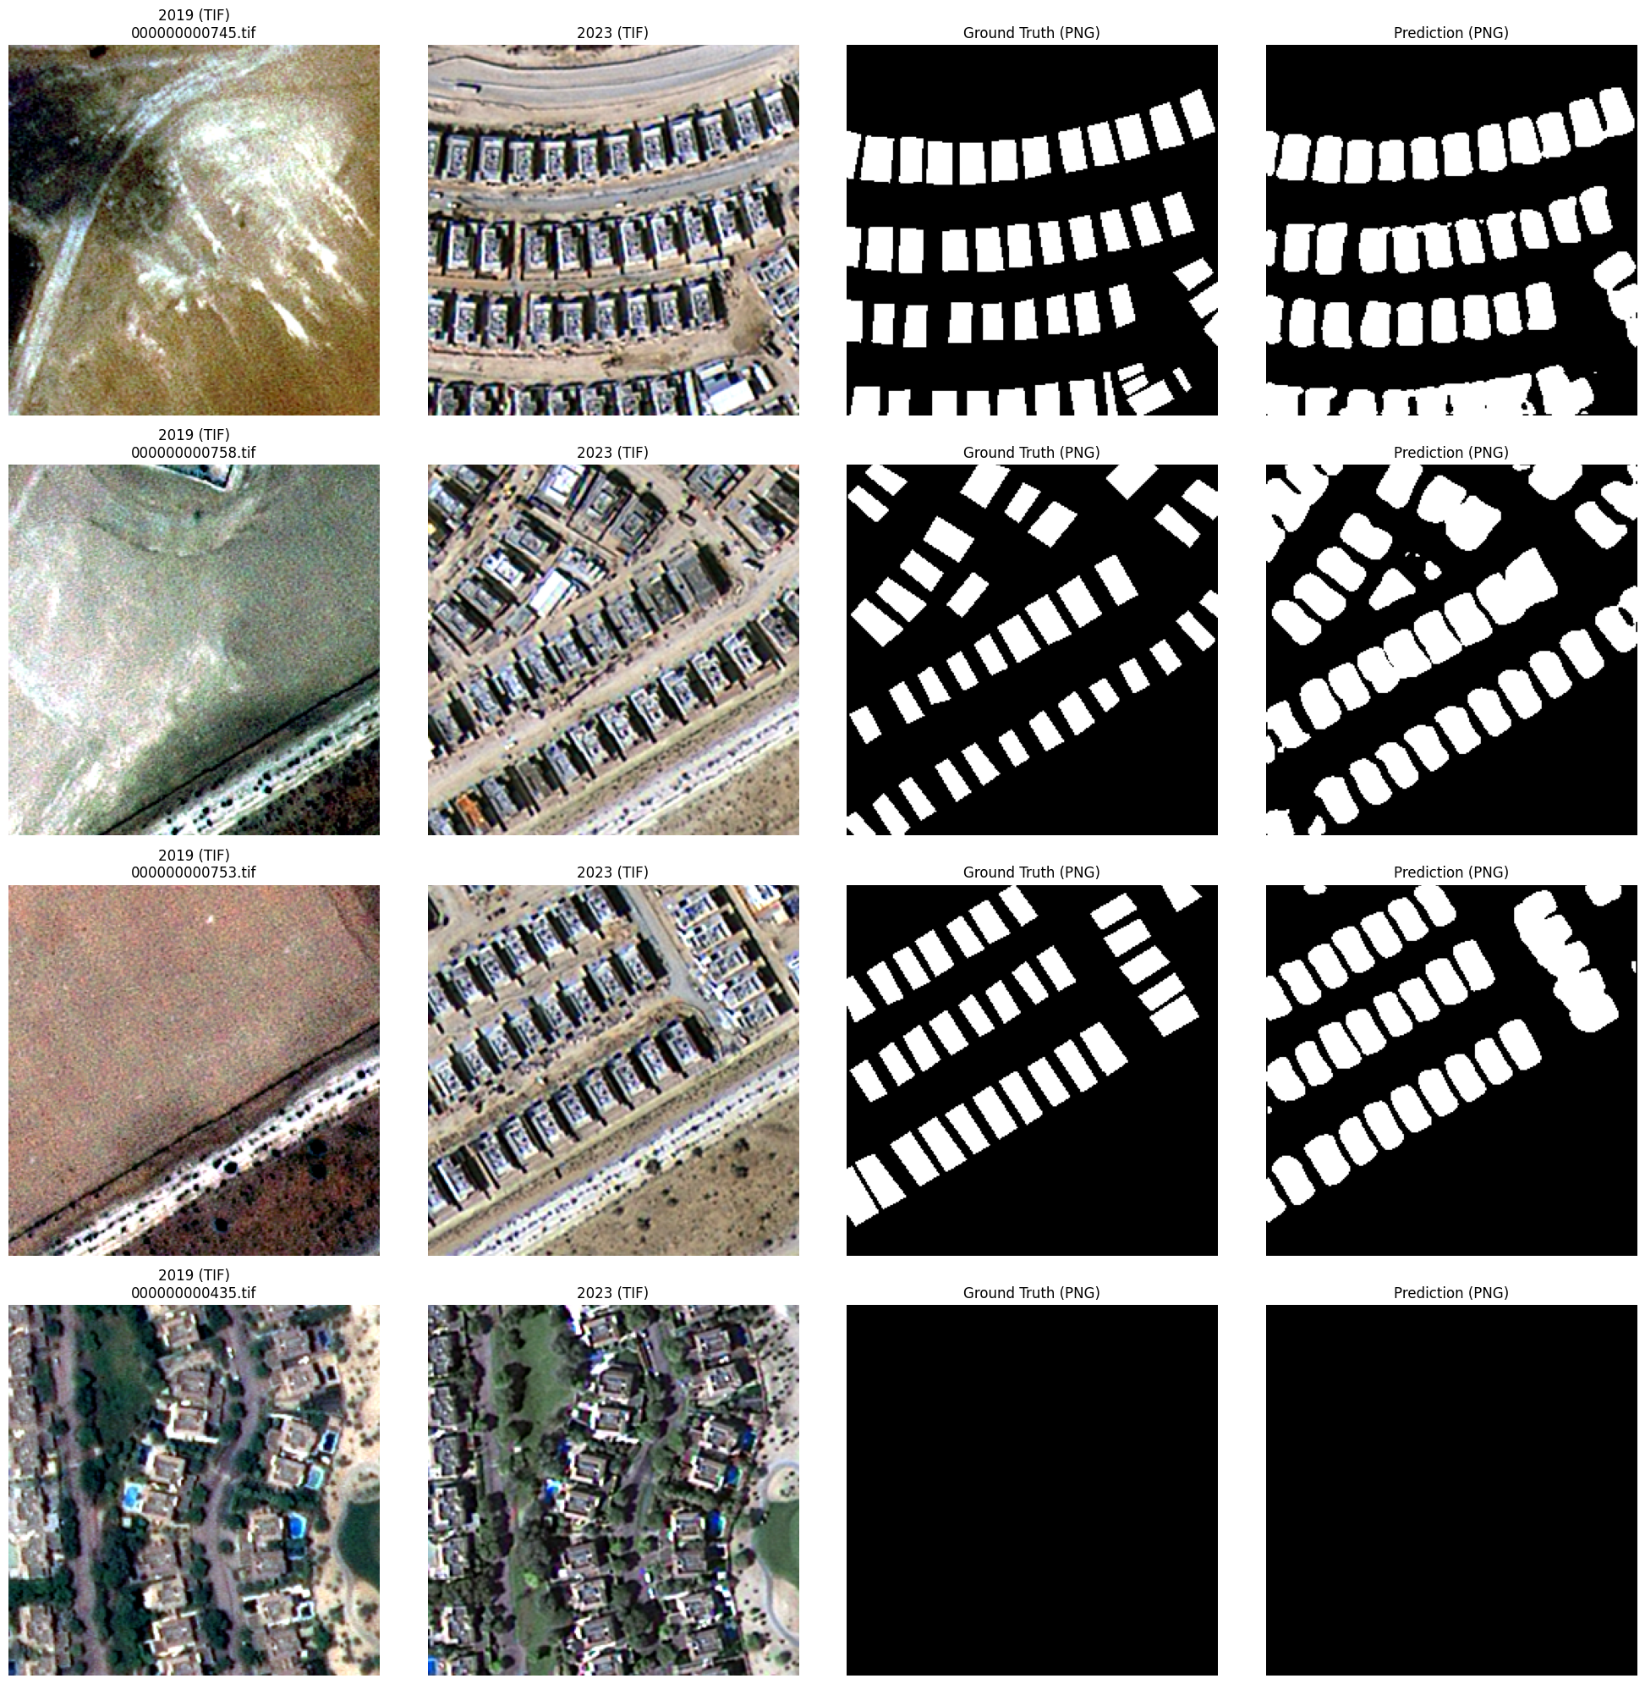
39/47

Slide 40
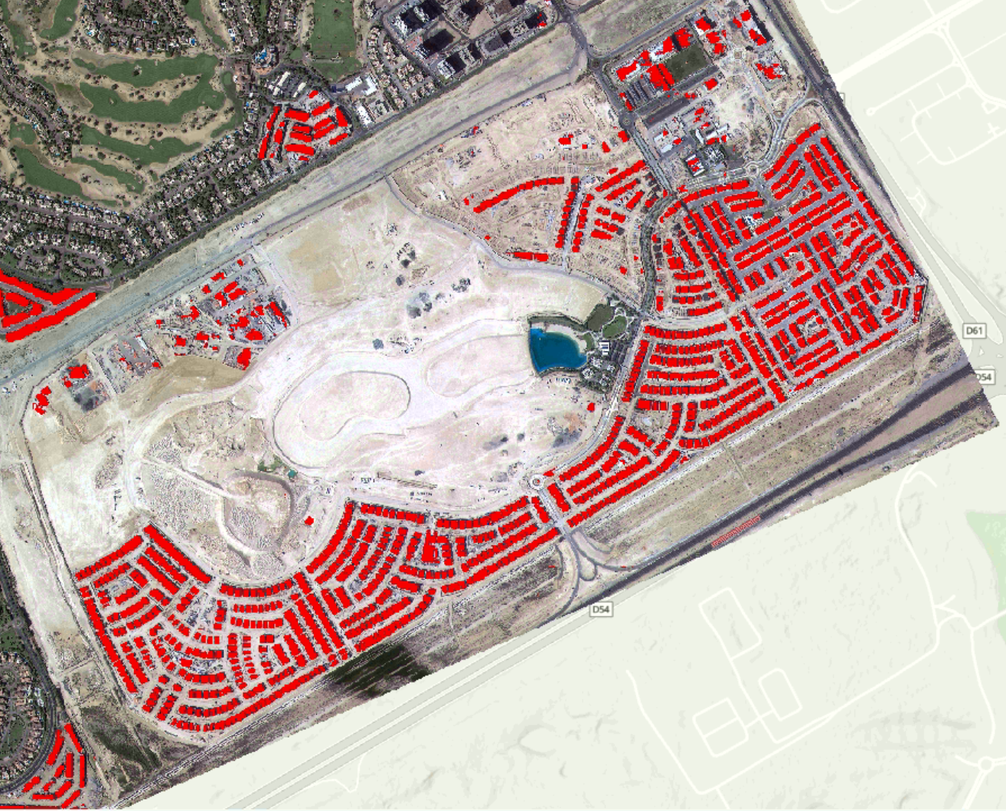
Fine-Tuned Model Inference Map
40/47
Pretrained VGG16 on LEVIR-CD Model Predictions
Fine-Tuned Semi-Supervised Model Predictions

Slide 41
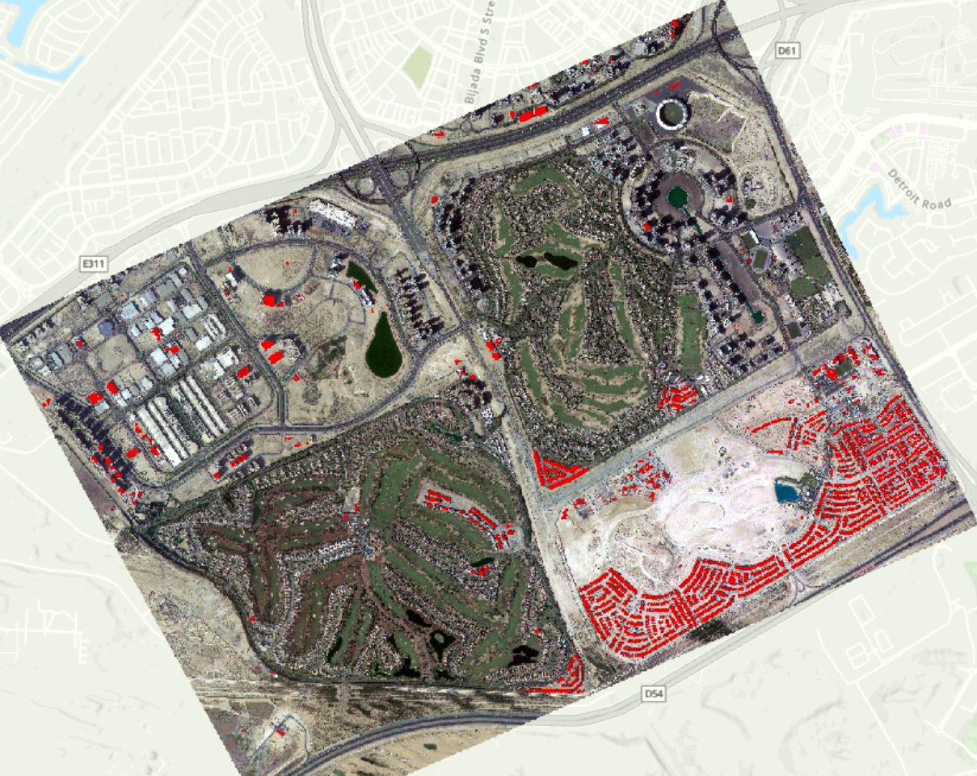
41/47
Pretrained VGG16 on LEVIR-CD Model Predictions
Fine-Tuned Semi-Supervised Model Predictions

Slide 42
Ablation Study
42/47
Fine-Tuning a checkpoint pretrained on LEVIR-CD:
F1: 0.8153, Precision: 0.7551, Recall: 0.8860, OA: 0.9763, Kappa: 0.8028, IoU: 0.6883
From scratch Fully Supervised training:
F1: 0.8048, Precision: 0.7242, Recall: 0.9055, OA: 0.9741, Kappa: 0.7911, IoU: 0.6733
From scratch Semi-Supervised training:
F1: 0.8321, Precision:0.7856, Recall: 0.8845, OA: 0.9789, Kappa: 0.8210, IoU: 0.7125
The 378 unlabeled samples, even without ground truth, provided useful structural information about what Dubai buildings look like that neither supervised baseline could access.

Slide 43
Project Challenges
43/47
The lack of annotated building masks (shapefile) presented a challenge in evaluating the accuracy of the model without ground-truth values.
  Addressed by manual annotations and semi-supervised learning.
Misalignment between the two scans, with the 2019 scan aligning to the correct basemap while the 2023 scan has some differences. Additionally, differences in image resolution and dimensions.
  Addressed by co-registration through several tools: georeferencing with manual control points, resample, and clip raster on ArcGIS Pro.
Mask blob challenge
  Addressed by making architectural changes to the model decoder
Computational and time limitations in model training and processing.
  Partially addressed through tiling.

Slide 44
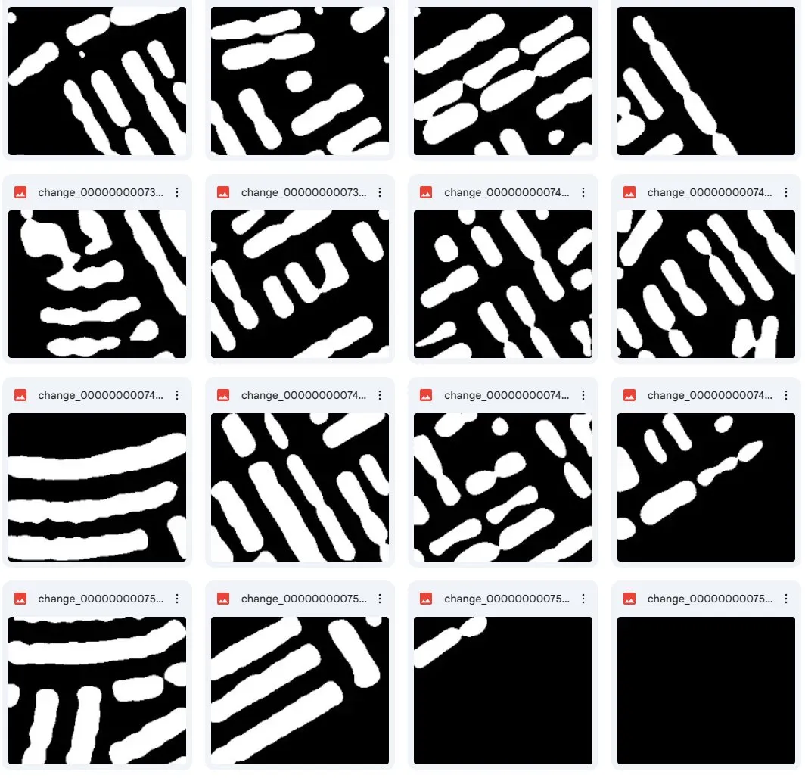
Mask Blob Challenge
44/47
The original model architecture discarded high-resolution, shallow features (l1 and l2) from the encoder, passing only low-resolution, deep features (l3, l4, l5) to the decoder. Because deep features identify what changed but lack the resolution to pinpoint where exact boundaries are, the model struggled to draw clean, distinct lines between adjacent structures.
The architecture was updated to include skip connections from all five encoder stages.
The decoder now progressively upsamples from the lowest resolution (1/16) back to full resolution, concatenating the corresponding encoder features at each step. This allows the model to combine mid-scale structure, edge awareness, and fine spatial details, resulting in crisp and accurate boundaries.

Slide 45
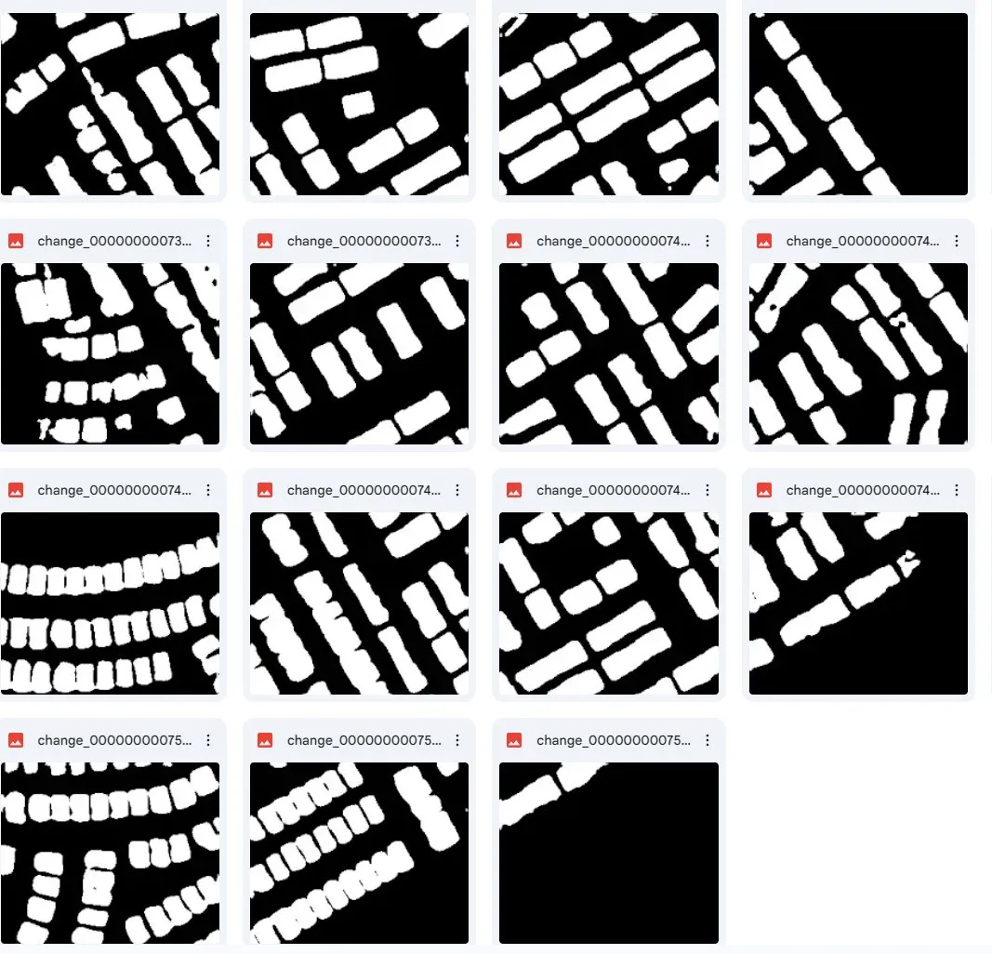
Mask Blob Challenge
45/47
Model predictions before architectural modification
Model predictions after architectural modification

Slide 46
Future Work
46/47
Experiment with different train/test/validation splits.
Experiment with different neural network architectures (e.g. ResNet)
Experiment with different loss function (e.g. Binary Cross-Entropy)
Tuning model hyperparameters (epochs, batch size, learning rate, etc...)
Morphological post processing of predicted masks

Slide 47
References
47/47
Dabove, P., Daud, M. & Olivotto, L. Revolutionizing urban mapping: deep learning and data fusion strategies for accurate building footprint segmentation. Sci Rep 14, 13510 (2024). https://doi.org/10.1038/s41598-024-64231-0
W. Liu et al., "Building Footprint Extraction From Unmanned Aerial Vehicle Images Via PRU-Net: Application to Change Detection," in IEEE Journal of Selected Topics in Applied Earth Observations and Remote Sensing, vol. 14, pp. 2236-2248, 2021, doi: 10.1109/JSTARS.2021.3052495.
T. Wu, Z. Sun, Z. Zhao, J. Wang, R. Yu and J. Ji, "SFCF-Net: A Cross-Hierarchical Progressive Feature Integration Network for UAV Image Change Detection," in IEEE Journal of Selected Topics in Applied Earth Observations and Remote Sensing, vol. 19, pp. 9127-9143, 2026, doi: 10.1109/JSTARS.2026.3664258.
Y. Li, C. L. P. Chen and T. Zhang, "A Survey on Siamese Network: Methodologies, Applications, and Opportunities," in IEEE Transactions on Artificial Intelligence, vol. 3, no. 6, pp. 994-1014, Dec. 2022, doi: 10.1109/TAI.2022.3207112.
Chen, H.; Shi, Z. A Spatial-Temporal Attention-Based Method and a New Dataset for Remote Sensing Image Change Detection. Remote Sens. 2020, 12, 1662. https://doi.org/10.3390/rs12101662
Revisiting Consistency Regularization for Semi-supervised Change Detection in Remote Sensing Images, Wele Gedara Chaminda Bandara and Vishal M. Patel, 2022
T. Chen, Z. Lu, Y. Yang, Y. Zhang, B. Du and A. Plaza, "A Siamese Network Based U-Net for Change Detection in High Resolution Remote Sensing Images," in IEEE Journal of Selected Topics in Applied Earth Observations and Remote Sensing, vol. 15, pp. 2357-2369, 2022
Diallo, R., Edalo, C., Awe, O.O. (2025). Machine Learning Evaluation of Imbalanced Health Data: A Comparative Analysis of Balanced Accuracy, MCC, and F1 Score. In: Awe, O.O., A. Vance, E. (eds) Practical Statistical Learning and Data Science Methods. STEAM-H: Science, Technology, Engineering, Agriculture, Mathematics & Health. Springer, Cham. https://doi.org/10.1007/978-3-031-72215-8_12
Jineon Kim, Yong-Ki Lee, Chae-Soon Choi, Sayedalireza Fereshtenejad, Jae-Joon Song, Scanline intersection similarity: A similarity metric for joint trace maps, Computers & Geosciences, Volume 175, 2023, 105358, ISSN 0098-3004, https://doi.org/10.1016/j.cageo.2023.105358

